Slide 1
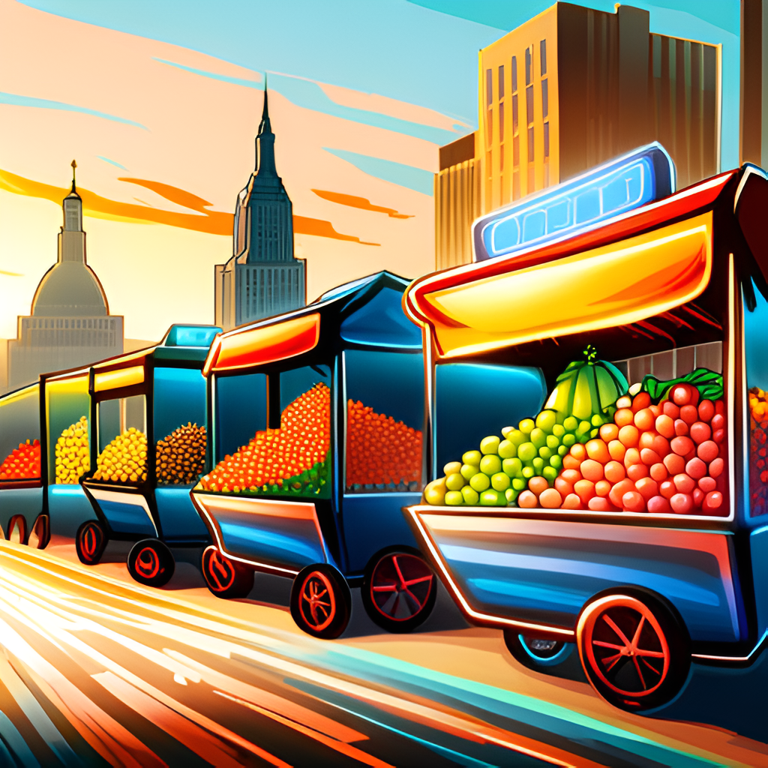

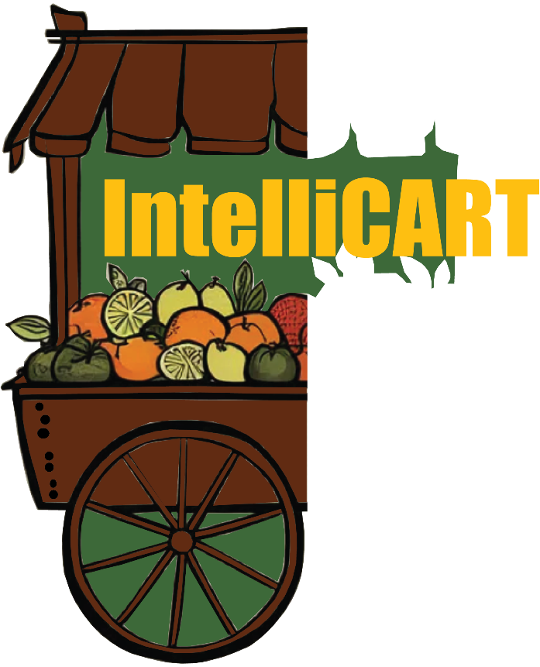

IntelliCART
(Intelligent RehriWala)
“Transforming Roadside Fruit and Vegetables Vendors with AI-Powered Classification and Customer Vendor Convenience”
Department of Computer Science, FAST-NUCES, Karachi, Pakistan
FYP-II

Slide 2
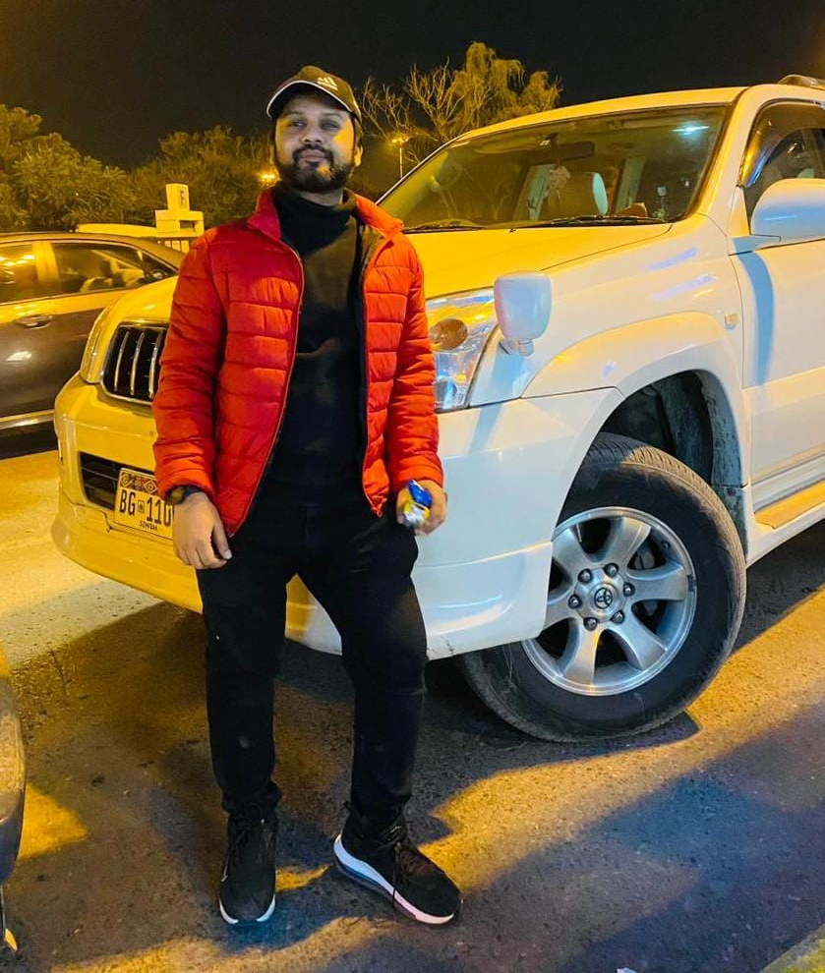
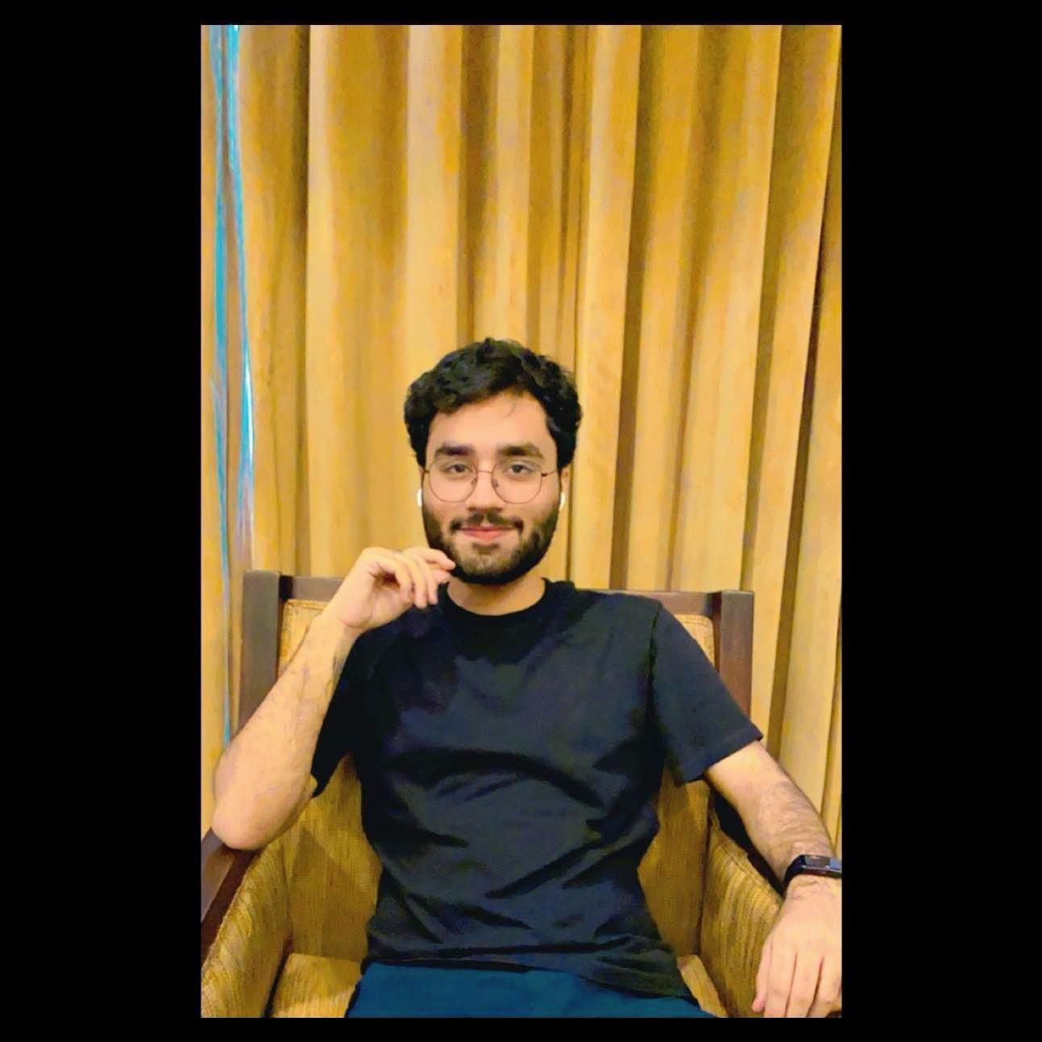
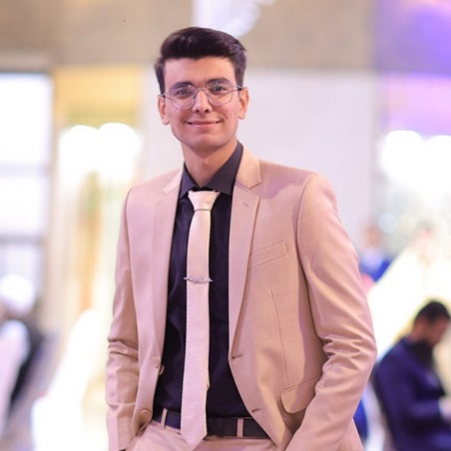
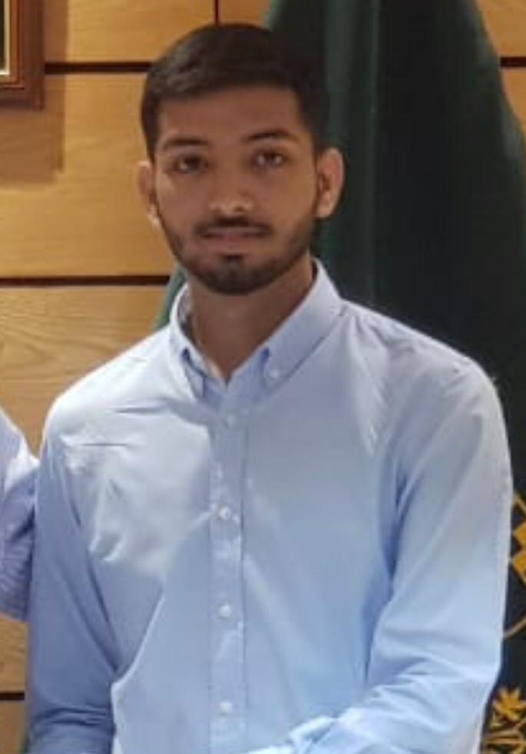
Project Team
Project Supervisor
Dr. Muhammad Farrukh Shahid
Project Members
Abdul Ahad Shaikh
20K-0477
ahadshaikh00001@gmail.com
0331-0277446
Mohammad Basil Ali Khan
20K-0477
basilkhan06@gmail.com
0335-3188200
Syed Jodat Ali Naqvi
20K-0155
alijodat16@gmail.com
0332-2755801

Slide 3
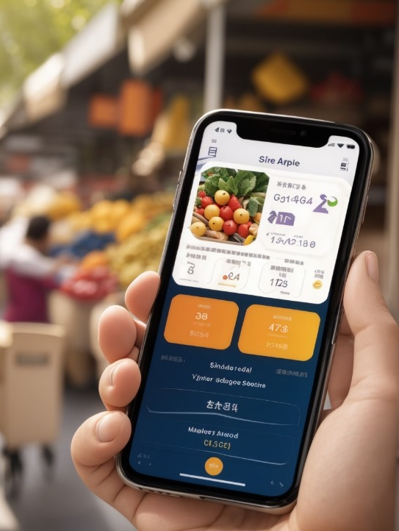
Agenda
Introduction
Problem Statement
Objectives
Proposed Scenario
Work contribution to Society
Some Existing Startups
Details of every dataset
Performance of each models on each dataset
Dataset Collection Drive
MobileNet
YOLO v8 for improved real-time object detection Demo Videos
Software Architecture
Application Design
Work Timeline
Tools Used
Achievement
References

Slide 4
Introduction
Welcome To The Future Of Urban Fruit’s And Vegs Supply Chain Solution.
This Project Aims To Revolutionize The Vegetables And Fruits Retail Market, Especially The Roadside Vendors. Harnessing The Power Of AI, This Project Will Enable Customers To Identify Fresh Fruits And Vegs Just From Their Cell Phones And Locate Their Required Fruit.
Upgrading These Rehris Would Provide Convenience To Both Customers And Sellers Through Smooth Retail, Also Reducing Traffic Congestions.

Slide 5
Problem Statement
Fruit vending market is quite unmanaged, neither the prices are controlled by government nor the quality, thus customers face difficulty in finding and classifying healthy fruits, leading to compromised choices. This sector even lacks the proper infrastructure to facilitate customers. Considering these we are stepping up to solve these issues leveraging the power of AI.

Slide 6
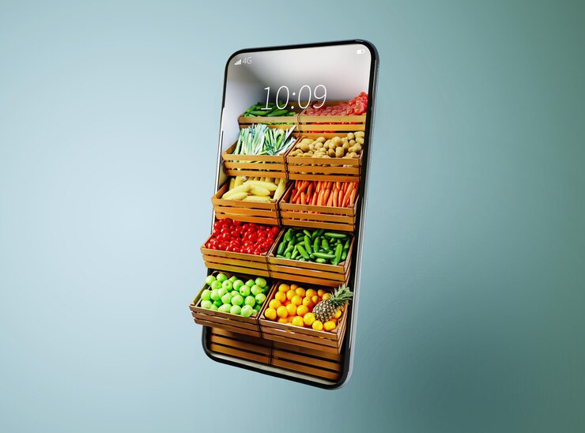
Objectives
Objective 1:
To classify fruits and vegetable based on their quality through image analysis of their characteristics using Computer Vision and Deep Learning.
Objective 2:
To support local vendors by providing them with an increased market reach.
Objective 3:
To provide real time fruit and vegetable quality monitoring.
Objective 4:
To avoid roadside congestions caused due to roadside fruit carts.
Objective 5:
To provide platform to customers where they can buy fresh fruits and vegetable hassle free.
Objective 6:
To let customers compare current government prices with vendor’s fruit prices.
Objective 7:
Enabling customers to locate the carts they nearby.
Objective 8:
In future, enabling fruit carts to be fully autonomous, allowing them to deliver fruits, move taking care of traffic, alerting for low-quality fruits, determining quality wise fruit prices and fully controlled.

Slide 7
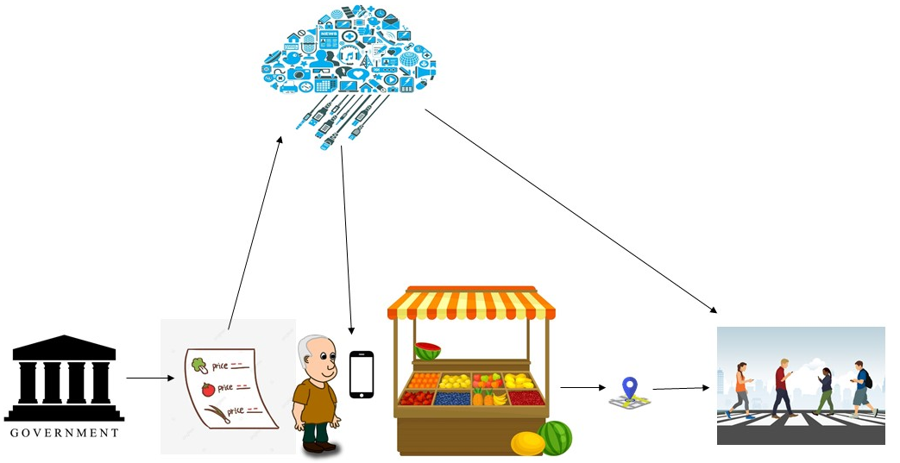
Proposed Scenario
Cloud Storage
IntelliCART
Government department that releases daily fruits and vegetable price list.
Customers
Global Position Service
Fruits / Vegetables Price List
Seller

Slide 8
Work contribution to Society
Enhancing Food Quality and Safety: The Smart Cart uses computer vision technology to assess the freshness of fruits and vegetables in real-time, helping ensure that customers receive high-quality and safe produce. This can reduce the risk of foodborne illnesses and improve overall public health.
Fair Pricing: The system's price verification capabilities help ensure that customers are charged fair prices for the fruits and vegetables they purchase. This prevents overcharging and promotes ethical business practices among fruit cart vendors.
Economic Opportunities: The Smart Cart can potentially expand the customer base for cart vendors, leading to increased income and economic opportunities for these small-scale entrepreneurs. It can also help them build better relationships with their customers.
Technology Integration: The Smart Cart integrates various technologies such as mobile applications, AI , Computer Vision, and GPS. This integration not only improves the efficiency of the cart operation but also provides an example of how technology can be harnessed for the benefit of society.

Slide 9
Some Existing Startups
Application Startup Name | Features
 | Fruit / Vegetable Price | Comparison with government prices | Freshness monitoring through Computer Vision | Nearby Cart location | Have Application
IntelliCART (Our Project) | ✓ | ✓ | ✓ | ✓ | ✓
FruitSabzi | ✓ | ✗ | ✗ | ✗ | ✗
Farmette | ✓ | ✗ | ✗ | ✗ | ✗
F2H- Farm to Home | ✓ | ✗ | ✗ | ✗ | ✗
FreshSabz | ✓ | ✗ | ✗ | ✗ | ✓
Subzi.pk | ✓ | ✗ | ✗ | ✗ | ✗

Slide 10
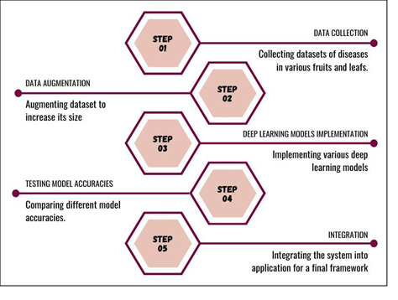
Methodology

Slide 11
Details of every dataset
We used Dataset from a total of 6 sources:
IEEE_DataPort – FruitGB.
Kaggle – Fruits and Vegetables.
Mendeley – FruitNet.
Mendeley- VegNet.
Dataset Camera (Our Own Dataset).
Mendeley – Fresh and Rotten Fruits.
(Links are provided towards the end of slides)
11

Slide 12
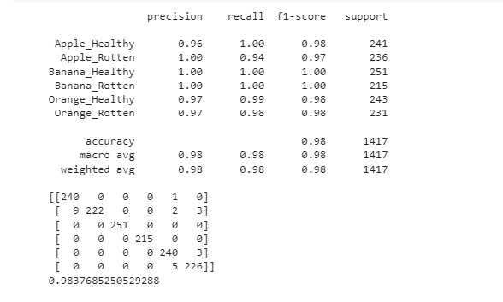
IEEE_DataPort - FruitGB
This Dataset contained the following classes:
Healthy Apples
Rotten Apples
Healthy Bananas
Rotten Bananas
Healthy Oranges
Rotten Oranges

Slide 13
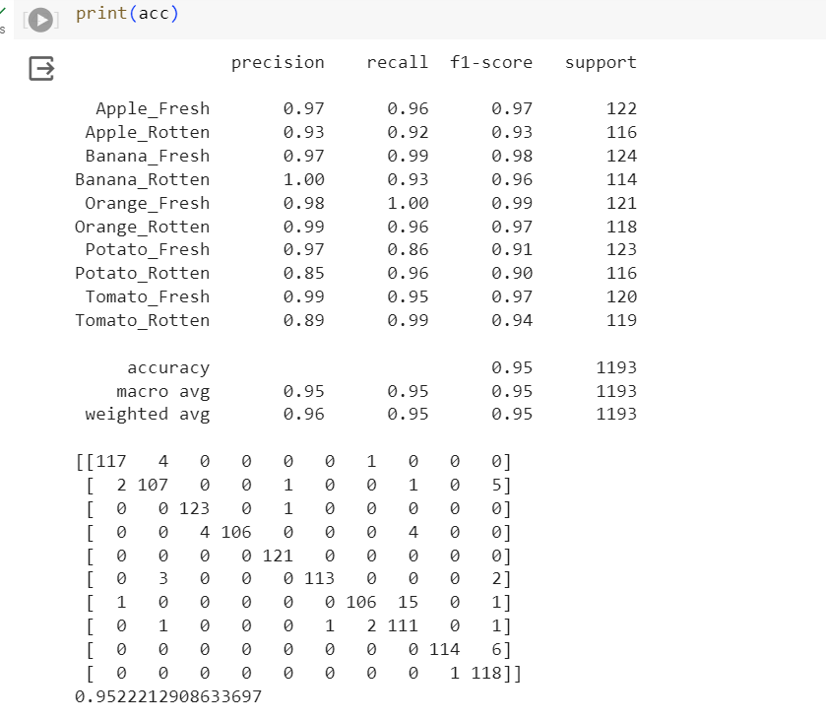
Kaggle – Fruits and Vegetables Dataset
This Dataset contained the following classes:
Fresh Apple
Rotten Apple
Fresh Bananas
Rotten Bananas
Fresh Oranges
Rotten Oranges
Fresh Potatoes
Rotten Potatoes
Fresh Tomatoes
Rotten Tomatoes

Slide 14
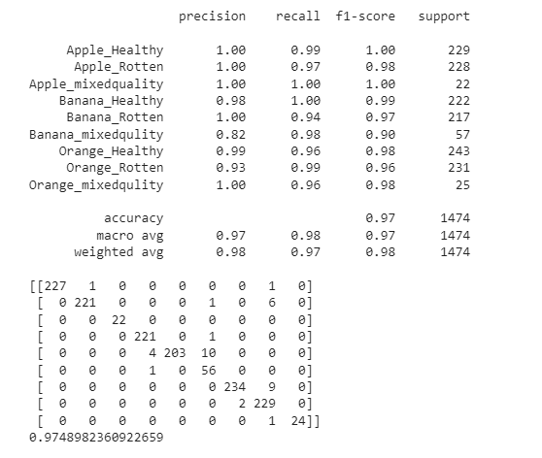
Mendeley- FruitNet
This Dataset contained the following classes:
Healthy Apple
Apple Mixed
Rotten Apple
Healthy Bananas
Banana Mixed
Rotten Bananas
Healthy Oranges
Oranges Mixed
Rotten Oranges

Slide 15
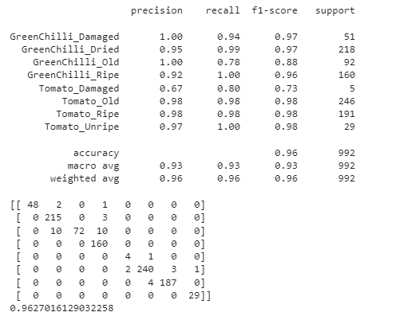
Mendeley- VegNet
This Dataset contained the following classes:
Damaged GreenChilli
Dried GreenChilli
Old Greenchilli
Ripe GreenChilli
Damaged Tomatoes
Old Tomatoes
Ripe Tomatoes
Unripe Tomatoes

Slide 16
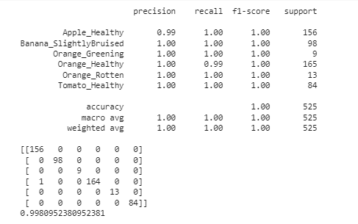
Dataset Camera (Our Own Dataset)
This Dataset contained the following classes:
Healthy Apple
Slightly Bruised Bananas
Green Oranges
Healthy Oranges
Rotten Oranges
Healthy Tomatoes

Slide 17
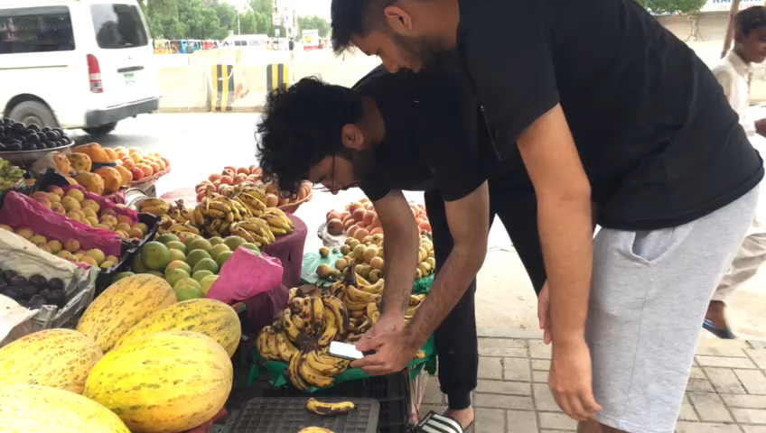
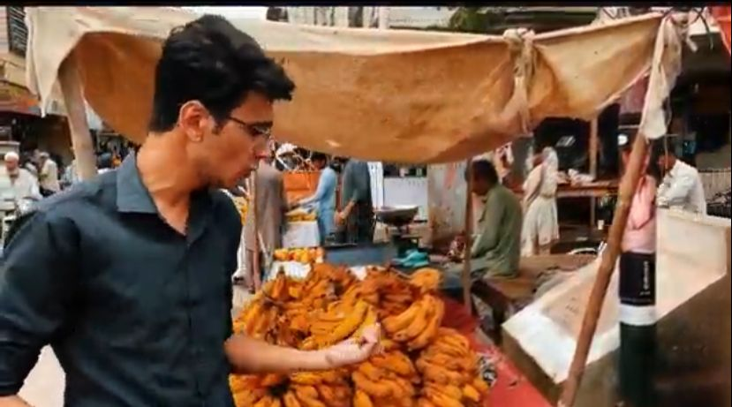
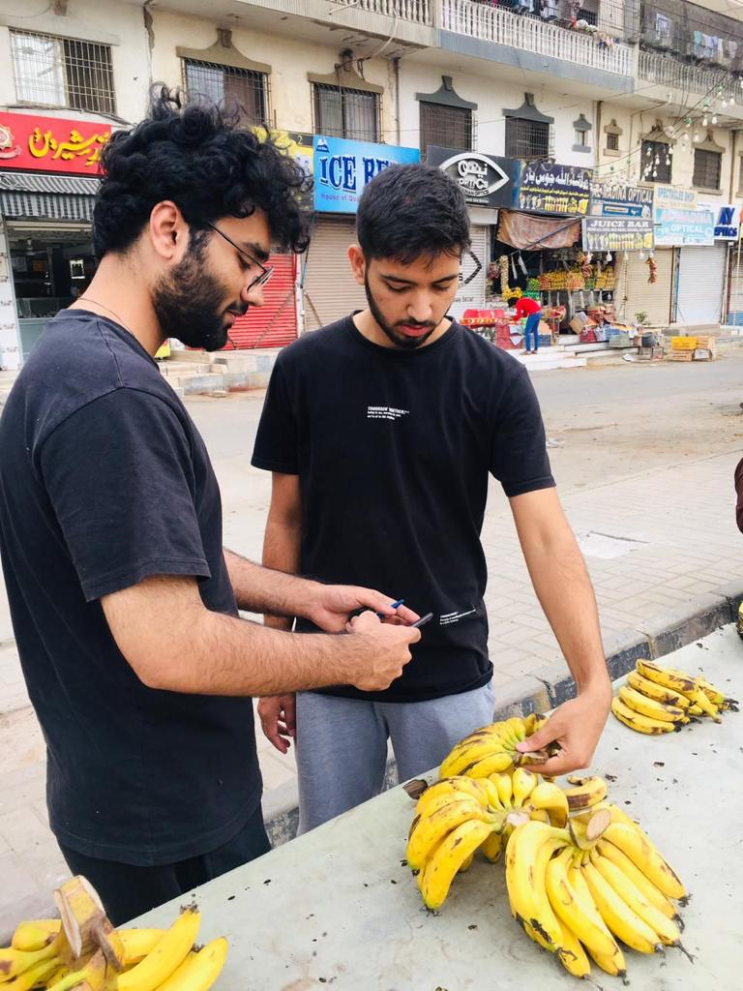
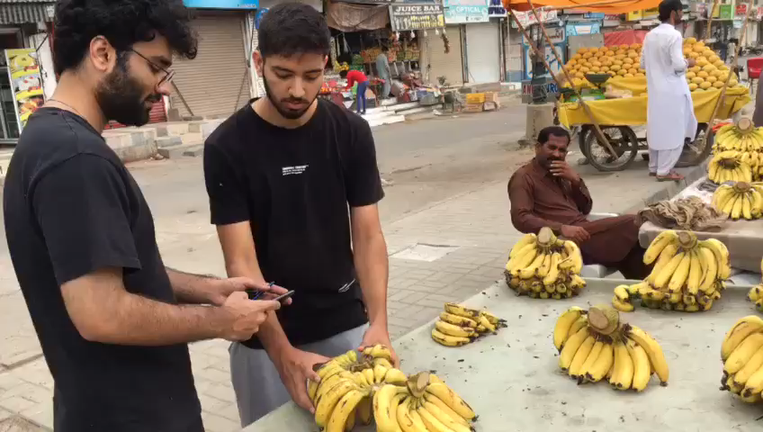
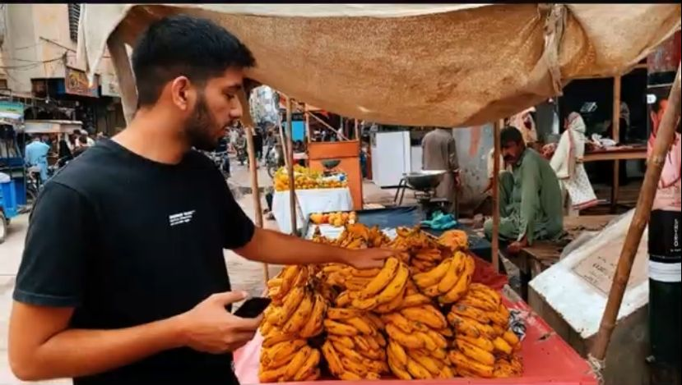
Dataset Collection Drive

Slide 18
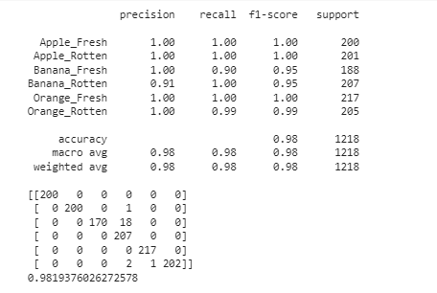
Mendeley – Fresh and Rotten Fruits
This Dataset contained the following classes:
Fresh Apples
Rotten Apples
Fresh Bananas
Rotten Bananas
Fresh Oranges
Rotten Oranges

Slide 19
Performance of each models on each dataset
 | Data Source | Data Size (no. Of images) |  | No. Of classes | MobileNet Results (Accuracy) | Inception-V3 Results (Accuracy) | VGG19 Results (Accuracy) | AlexNet Results (Accuracy) | Reference
 |  | Train | Test
1 | IEEE_DataPort - FruitGB | 5890 | 1417 | 6 | 98.3% | 99.0% | 99.01% | 87.58% | [1]
2 | Kaggle - Fruits and Vegetables dataset | 4804 | 1196 | 10 | 95.22% | 92.79% | 89.85% | 81.14% | [2]
3 | Mendeley - FruitNet | 5914 | 1474 | 9 | 97.49% | 97.35% | 96.94% | 92.33% | [3]
4 | Mendeley - VegNet | 3982 | 992 | 8 | 96.27% | 94.15% | 91.73% | 77.01% | [4]
5 | Dataset Camera | 2108 | 525 | 6 | 99.81% | 97.90% | 99.42% | 99.04% | [5]
6 | Mendeley - Fresh and Rotten Fruits | 4594 | 1146 | 6 | 98.19% | 99.26% | 97.86% | 61.24% | [6]

Slide 20
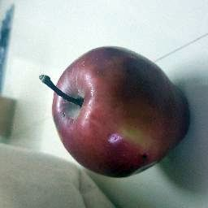
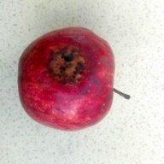
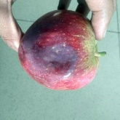
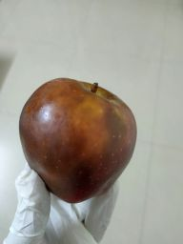
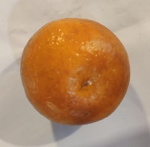
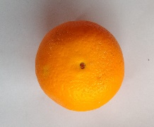
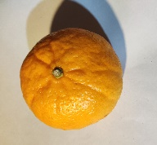
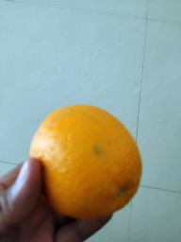
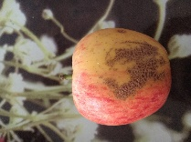
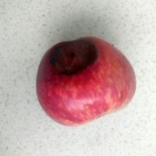
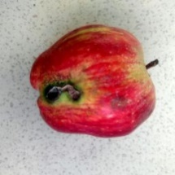
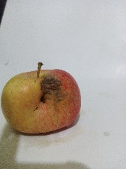
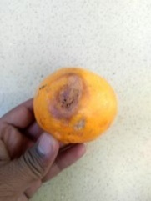
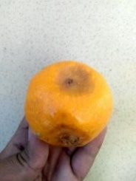
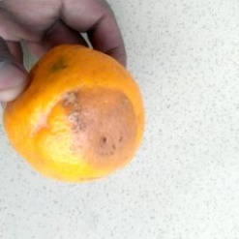
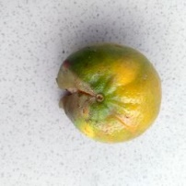
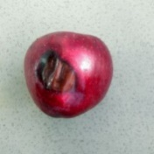
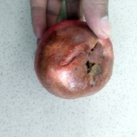
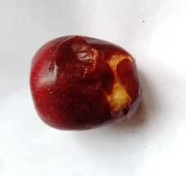
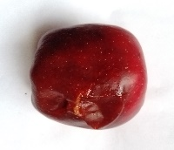
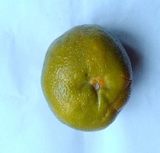
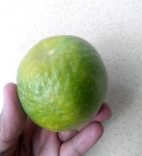
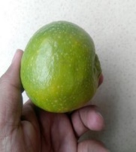
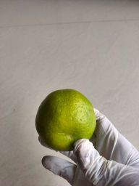
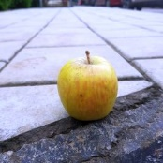
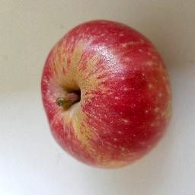
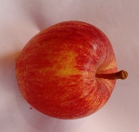
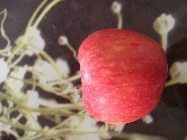
Dataset
CLASS | SNAPSHOTS
Apple Blotch
Apple Scab
Apple Rotten
Apple Healthy
CLASS | SNAPSHOTS
Orange Healthy
Orange Rotten
Orange Greening
Apple Dataset Sample
Orange Dataset Sample

Slide 21
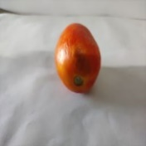



























Dataset (Contd.)
CLASS | SNAPSHOTS
Banana Firm
Banana Slightly Bruised
Banana Heavily Bruised
CLASS | SNAPSHOT
Tomato Damaged
Tomato Ripe
Tomato Unripe
Tomato Old
Banana Dataset Sample
Tomato Dataset Sample

Slide 22




















Dataset (Contd.)
CLASS | SNAPSHOTS
Green Chili Damaged
Green Chili Dried
Green Chili Old
Green Chili Ripe
Green Chili Unripe
Green Chili Dataset Sample

Slide 23

MobileNet
Integrated MobileNet in our Application
MobileNet is a convolutional neural network that uses depth wise separable convolutions and has an input size of 224 by 224.
Mobile Net split the convolution into a 3x3 depth-wise convolution and a 1x1 pointwise convolution, as shown in the figure.
We implemented MobileNet on our dataset and achieved an accuracy of 95%.
TPR average | 0.9058942945130736
FPR average | 0.002858193302300445
TNR average | 0.9971418066976995
FNR average | 0.0941057054869264

Slide 24


MobileNet Accuracy and Loss

Slide 25
Why we chose MobileNet? (Best Accuracy)
Many real-life classification applications, such as robotics, autonomous driving, smartphone, etc., the
classification task is highly constrained by the computational resources that are available.
The problem thus becomes to pursue the optimal accuracy subject to a limited computational budget (i.e.
memory and/or MFLOPs).
MobileNet is a type of convolutional neural network (CNN) that has been specifically designed for use on mobile devices with limited computational resources. It has the following advantages:
1. Lightweight architecture: MobileNet has a smaller number of parameters compared to other deep learning models, which makes it ideal for deployment on mobile devices and other embedded systems with limited resources.
2. Speed: Because MobileNet has fewer parameters, it is faster to train and run than other deep learning models. This makes it an ideal choice for real-time applications such as object detection and image recognition.
3. Accuracy: Despite its lightweight architecture, MobileNet can achieve high accuracy on a variety of tasks, including image classification and object detection. It has been shown to perform well on benchmark datasets such as ImageNet.
4. Compatibility: MobileNet is compatible with a wide range of deep learning frameworks, including TensorFlow, Keras, and PyTorch. This makes it easy to integrate MobileNet into existing deep learning workflows and frameworks.

Slide 26




YOLO v8 for improved real-time object detection Demo Videos

Slide 27



YOLO v8 for improved real-time object detection (Contd.) Demo Videos

Slide 28

Software Architecture

Slide 29

Application Design

Slide 30



Application Design (Contd.) Customer Side
Customer Side Login and Registration Screen
Customer Side Nearby Vendor Cart Screen
Customer Side Searching for Vendor Carts Screen

Slide 31

Application Design (Contd.) Customer Side
Customer Side Feedback to Vendor Screens

Slide 32


Application Design (Contd.) Customer Side
Customer Side Favorites Vendor Screen
Customer Side Freshness Quality Assessment Screen

Slide 33



Application Design (Contd.) Vendor Side
Vendor Side Login And Registration Screen
Vendor Side Dashboard Screen
Vendor Side Product Screen

Slide 34


Application Design (Contd.) Vendor Side
Vendor Side Sales Screen
Vendor Side Update Screen

Slide 35

Application Design (Contd.) Customer Freshness Quality Assessment Flow

Slide 36

Application Design (Contd.) Vendor/Customer Real Time Freshness Quality Assessment Flow

Slide 37

Application Design (Contd.) Customer Tracking Vendor Cart Location Flow

Slide 38
Work Timeline
Timeline | Phases | Team Roles | Checks
Month 1 | Literature Review | Ahad, Jodat | Completed
Discussing the progress with Dr. Muhammad Farrukh Shahid (PI) |  |  | Done
Month 2 | Data Collection | Ahad, Basil, Jodat, Dr. Farrukh | Completed
Discussing the progress with Dr. Muhammad Farrukh Shahid (PI) |  |  | Done
Month 3 | Feature Extraction | Ahad | Completed
Discussing the progress with Dr. Muhammad Farrukh Shahid (PI) |  |  | Done
Month 4 | Deep Learning Model | Ahad, Jodat | Completed
Discussing the progress with Dr. Muhammad Farrukh Shahid (PI) |  |  | Done
Month 5 | Model Integration in Application | Jodat, Basil | Completed
Discussing the progress with Dr. Muhammad Farrukh Shahid (PI) |  |  | Done
Month 6 | Mobile Application Design | Basil, Ahad | Completed
Discussing the progress with Dr. Muhammad Farrukh Shahid (PI) |  |  | Done
Month 7 - 8 | Mobile Application Development | Ahad, Jodat | Completed
Discussing the progress with Dr. Muhammad Farrukh Shahid (PI) |  |  | Done
Month 9 - 10 | System Integration | Jodat | Completed
Discussing the progress with Dr. Muhammad Farrukh Shahid (PI) |  |  | Done
Month 11 | Evaluation and Testing | Ahad | Completed
Discussing the progress with Dr. Muhammad Farrukh Shahid (PI) |  |  | Done
Month 12 | Documentation and Reporting | Basil, Jodat, Ahad | Completed
Submitting Final Report |  |  | Done

Slide 39








Tools Used

Slide 40

Achievement
Selected Among 300 applications who Participated in the 5G Hackathon in 5G Centre NUST Islamabad

Slide 41
References
[1] Top Indian Fruits: IEEE-dataport.org - fruitsgb-top-indian-fruits-quality
[2] Fruits and Vegetables Dataset: Kaggle - Fruits and Vegetables dataset
[3] Mixed Quality Fruits: FruitNet: Indian Fruits Dataset with quality (Good, Bad & Mixed quality)
[4] Vegetable Dataset: VegNet: Vegetable Dataset with quality (Unripe, Ripe, Old, Dried and Damaged)
[5] Our own Dataset: Our Dataset
[6] Fresh and Rotten Fruits: Fresh and Rotten Fruits Dataset for Machine-Based Evaluation of Fruit Quality

Slide 42


